Slide 1



Slide 2
Expulsion of fetus/embryo before 22 WOG.
Termination of pregnancy before 22 WOG.
Abortion is the expulsion or extraction of an embryo or fetus from its mother weighing 500gm or less when it is not capable of independent survival (WHO).
Spontaneous abortions are usually termed as miscarriages.
Induced abortion: is defined as a process by which pregnancy is terminated before fetal viability.

Slide 3
Nearly half of all abortions worldwide are unsafe, and nearly all unsafe abortions (98%) occur in developing countries.
In the developing world, 56% of all abortions are unsafe, compared with just 6% in the developed world.

Slide 4
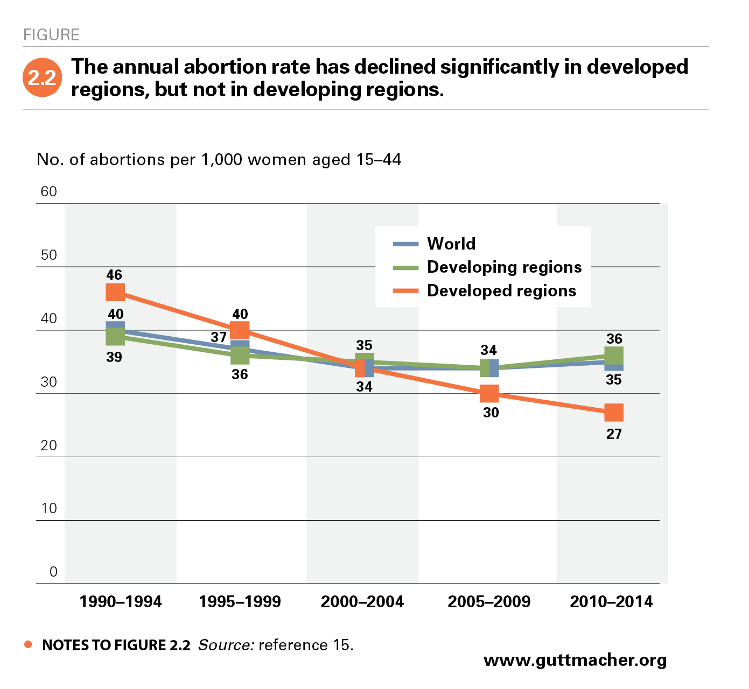

Slide 5

MMR is 239 death/100,000 live births. (MMMS,2016).
n 2018, neonatal mortality rate for Nepal was 19.9 deaths per 1,000 live births.(World Data Atlas)
Complication related to abortion is the leading cause of maternal mortality in our context which was 5.4% in 1998 and now that was increased in 7%( MMM study, 2008/2009)

Slide 6

An estimated 323,000 abortions were performed in Nepal in 2014. This number translates to a rate of 42 abortions per 1,000 women aged 15–49.
Nepal’s 2014 annual abortion rate falls between the rates estimated for nearby Bangladesh (37 per 1,000) and Pakistan (50 per 1,000).

Slide 7

Nationwide, fewer than half (42%) of all abortions were provided legally in government-approved facilities. The remainder (58%) were clandestine procedures provided by untrained or unapproved providers or induced by the pregnant woman herself.
Currently IPAS is supporting for safe abortion in Nepal.
Notes:
Candestine-secret illegal activity

Slide 8
Staff nurses can be trained to provide abortions up to 8weeks of pregnancy without the presence of a trained physician.
The first government abortion services officially began on 18th March 2004 at the Maternity Hospital in Kathmandu.

Slide 9
Safe abortion: are those performed in early pregnancy by well trained Practitioner,
(listed/ registered practitioner) using medical & surgical method in safe environment in registered (listed) institution.
When abortions are performed in safe conditions, mortality and morbidity rates are generally very low. The probability of complications and death increases with gestation.

Slide 10

So efforts should be made to inform the general public about the importance of doing abortion before 12 weeks when required.
Health risk for women, rise with each week, when abortions are performed after 12 weeks.
Only specially trained manpower in specially equipped health facilities can perform abortion after 12 weeks.

Slide 11

The WHO defines “unsafe abortion” as a “procedure for terminating an unwanted pregnancy (carried out) either by a person lacking the necessary skills or in an environment lacking minimum medical standard or both”.
Due to lack of knowledge, difficult on getting services and legal restrictions majority of women or family members choose to do unsafe abortions.

Slide 12

To stop childbearing
To postpone childbearing
Socio-economic conditions
Relationship problems
Age
Health
Coercion

Slide 13

Immediate Complications:
Incomplete abortion
Hemorrhage
Endometriosis
Intra abdominal injury
Septic shock

Slide 14

Chronic pelvic pain
Pelvic inflammatory disease.
Infertility
Ectopic pregnancy
Premature labor
Spontaneous abortion
RH sensitization

Slide 15
Comprehensive abortion care (CAC):
CAC is an approach of providing abortion care services that address various factors of the woman’s health needs physical, mental, her personal circumstances as well her ability to access the service.

Slide 16
Thus CAC includes affordable and accessible abortion care and other RH service eg. Counselling and informed consent for the termination of pregnancy, informed choice for post abortion FP, identification and treatment of STI/RTI.
CAC consists of three key elements; client’s choice, access and quality of service.

Slide 17
Abortion law :
Nepal’s House of Representatives takes up and posses the Bill on legalization of abortion in Nepal on 14th March 2002. The Bill received Royal Assent and become low on 6th September 2002.
The first legal abortion services opened at the Maternity Hospital in Kathmandu on 18th March 2004. This service has been gradually expanded to outside to Kathmandu valley in government and non governmental sector.

Slide 18
The new abortion law provisions:
As amended by the legal Code grants the right to termination of pregnancy to all women without regard to their past or present marital status, on the following grounds and with one important expectation:
The right to terminate a pregnancy of up to 12 weeks voluntarily.
The right to terminate a pregnancy of up to 18 weeks if the pregnancy is due to rape or incest.

Slide 19
The right to seek abortion upon the advice of a medical practitioner at any time during a pregnancy if the pregnancy poses a danger to women’s life or her physical or mental health, or in cases of fetal abnormality or impairment.

Slide 20
Abortion on the basis of sex selection is prohibited. Amniocentesis is prohibited for purpose of sex determination for abortion. Anyone found guilty of conducting or causing to be conducted such an amniocentesis test is to be punished with imprisonment of 3-5 months.
Anyone found guilty of performing or causing to be performed an abortion on the basis of sex selection is to be punished with one additional year of imprisonment.

Slide 21
The consent of the husband or guardian is not required for women over 16 years of age, and for those under 16, the “guardian” can include any adult friend or family members.
The regulation specify that for pregnancy up to 12 weeks MVA can be used, while beyond 12, MVA and dilation and evacuation (D&E) can be used.

Slide 22
A health care institution or provider wishing to provide abortion needs to be registered with the Ministry of Health’s Department of Health Services.
Provider or institution are permitted to charge for the cost of pregnancy termination, but are required to maintain transparency about price.

Slide 23
Induced abortion technologies:
Variety of technologies have been invented and implemented in the world to induce the abortions.
The choice of these technologies depend on the length of time of a woman has been pregnant, available of trained manpower and other essential facilities. Manual Vacuum Aspiration (MVA) has been widely used to induce abortion up to 12 weeks.

Slide 24
MVA, is relatively inexpensive, easy to operate and maintain, less likely to involve complications and more cost effective than dilation and surgical curettage under general anesthesia.
The rate of medical complications with vacuum aspiration (about one in 2000 procedures) is half that for surgical curettage (almost one in 100).

Slide 25
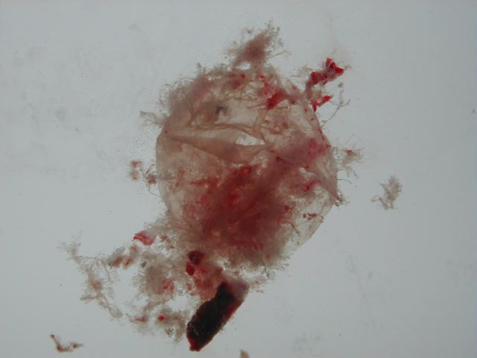

Slide 26


Removal of pregnancy contents by some mechanical means
Vacuum most commonly used12-13 weeks is the upper limit of gestational age
Usually performed in free standing clinics

Slide 27

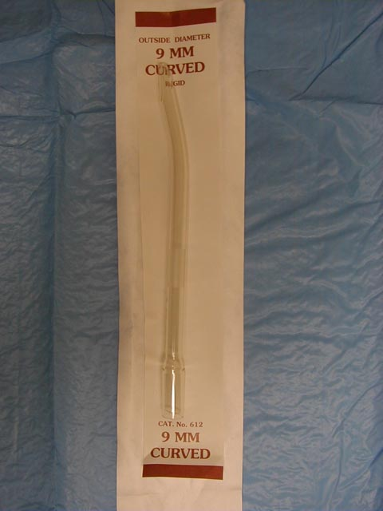
The cervix must be dilated to permit larger diameter suction curettes
Pre-medication with NSAID
Local (paracervical block), spinal, conscious sedation, or general anesthesia

Slide 28
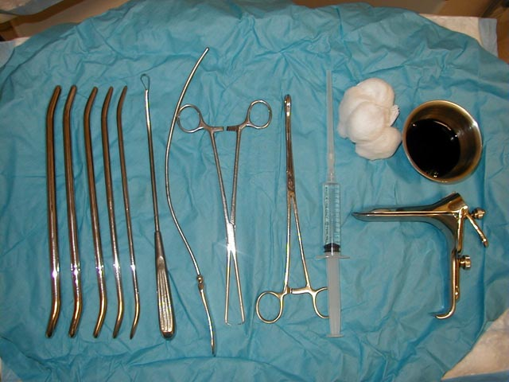
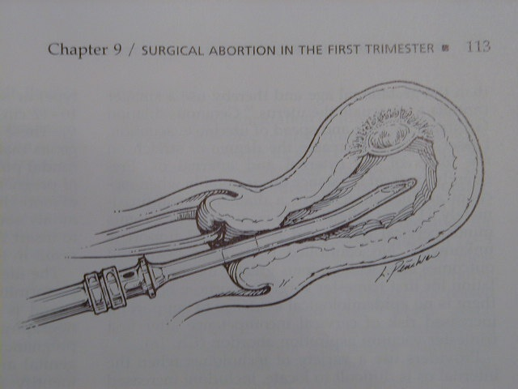

Slide 29
Medical: Use of Antiprogestins (for example Mifepristone 200 mg orally (call after 48 hrs according to hospital rule) to halt the growth of the fetus, in combination with prostaglandins (such as misoprostol 4 tabs 800mcg vaginally) to stimulate contractions of the uterus can be safely used before nine weeks of gestation.

Slide 30

Mifepristone (RU486)
  analogue of progestin norethindrone
  strong affinity for the progesterone receptor, acting as an antagonist
  a single oral dose given to women 5 weeks or less produces abortion in 85% of cases

Slide 31

Women less than 49 days LMP with confirmed β-hCG( pregnancy)
600mg mifepristone on day 1
On day three, return for Prostaglandin, Misoprostol 400 mcg orally
Patient remain in clinic four hours, during which time expulsion of pregnancy usually occurs.

Slide 32

Post abortion care (PAC) is the care given to a woman who has had an unsafe, spontaneous or legally induced abortion.
Post abortion care is one of the important elements of safe motherhood program to reduce the risk of long term illness or disability, and death of women due to incomplete abortion.

Slide 33

WHO has identified the prompt treatment of incomplete abortion as an essential element of obstetric care that should be available at every district level hospital.
Post abortion care service is one of important component of Reproductive Health and Safe Motherhood program in Nepal.

Slide 34
MoHP, Family Health Division(FHD) has set goal to make available of quality PAC services gradually in all the districts of Nepal.
FHD initiated PAC services at the Maternity Hospital in Kathmandu in 1995. This service has been gradually expanded to outside of Kathmandu.

Slide 35
According to National Medical Standard for Reproductive Health Services Vol II: Comprehensive Post abortion Care includes:
- Good Interpersonal Services: Counseling and client-provider interaction to identify and respond to women’s emotional and physical health and other needs and other concerns.

Slide 36
Treatment: Treatment of incomplete and unsafe abortions and resulting complications that can become life threatening at any time; for this it is essential that emergency treatment is available at any time.
- Family Planning Services: Contraceptive and family planning services to help women to prevent unwanted pregnancy and practice birth spacing.

Slide 37
Classification of abortion
Abortion
Spontaneous Induced
Isolated Recurrent/Habitual Legal Illegal
Threatened Missed Inevitable
complete incomplete
septic
May go to term Missed inevitable
complete incomplete
septic

Slide 38

Emergency treatment: of incomplete abortion and potentially life-threatening complications
Post abortion FP counseling and services:
Link with other reproductive healthcare system and including HIV AIDs .
Encourage community Participation

Slide 39
Emergency
FP Counseling
Treatmentt
and Services
Community participation
Linkage to Other
Management of Complication
Reproductive
Health Services

Slide 40
Emergency Treatment
Initial screening (triage) for emergency conditions
Talking to the client regarding her condition
Medical assessment
Referral or transfer for extensive treatment (e.g., major surgery)
Stabilization (IVs, antibiotics) prior to Manual Vacuum Aspiration (MVA)*
Uterine evacuation by MVA

Slide 41
Linkages to other reproductive health services:
Treatment of sexually transmitted diseases
Cervical cancer screening for women over age 30 and 35
Infertility services
Pre-pregnancy advice (e.g., nutrition, immunization, management of existing medical conditions)

Slide 42
Community Participation
Public awareness about availability of PAC services
Counseling to mothers’ groups for use of quality PAC/CAC service and use of FP after post abortion service

Slide 43
FP Services
Unsafe abortion is a prime indicator of unmet need for FP
Failure to provide FP is a major contributor to the problem of unsafe abortion
Emergency treatment is not linked to FP counseling or services

